Slide 1
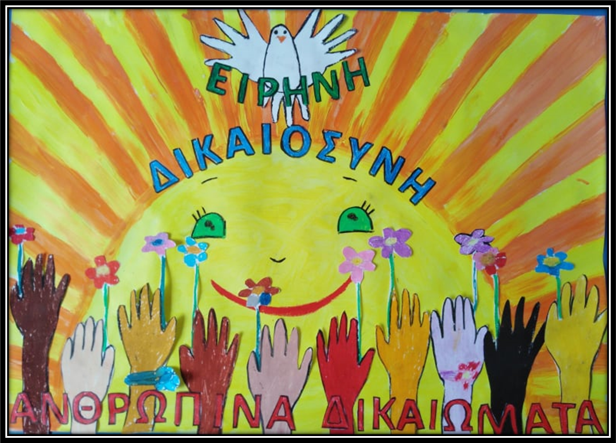
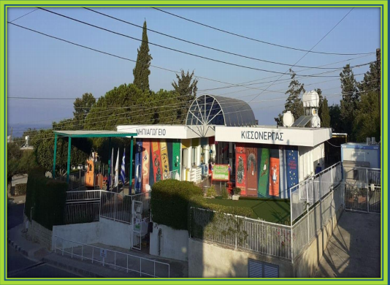
NIPIAGOGIO KISSONERGAS GEORGIOU MICHAEL Making a poster for Peace, Justice and human rights 2020-2021
ΜΤ
This poster won in the competition
Walk the global Walk!
Teacher: Eleni I.Papakyriakou

Slide 2
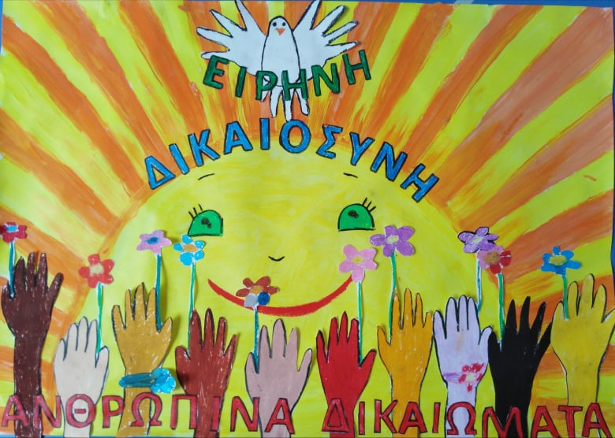
In Cyprus, there was a competition for Global walk, we submitted one of our drawings on Peace, Justice and Strong Institutions .
Our Poster is awarded and then they will put it up in advertising billboards all across the island!

Slide 3
Children said their ideas how we could represent peace on our Poster and they suggested a dove. Then for Justice they suggested the Sun who arise for everyone! For human rights they suggested to make the outline of different hands with different colours holding flowers of hope!

Slide 4
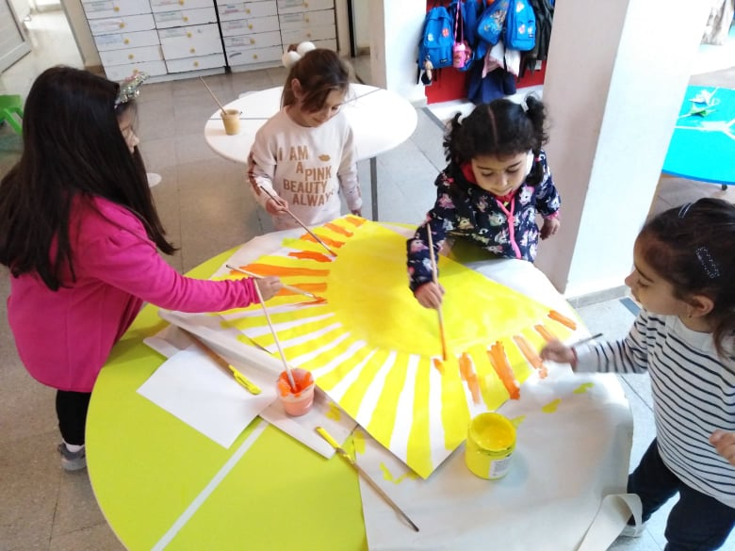
Here is the procedure that we followed! We made the Sun with bright colours!!!

Slide 5
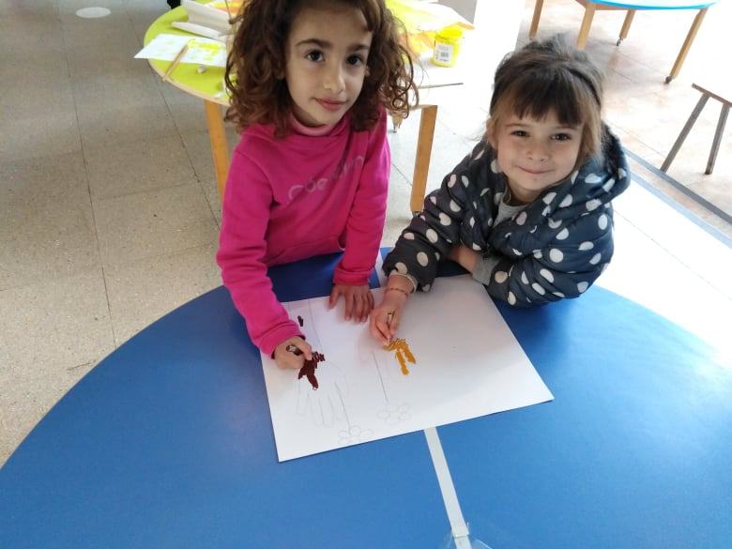
We made our hand outlines and choose different colour to colour it in

Slide 6
We help to make the outline of the dove with a child’s hands

Slide 7
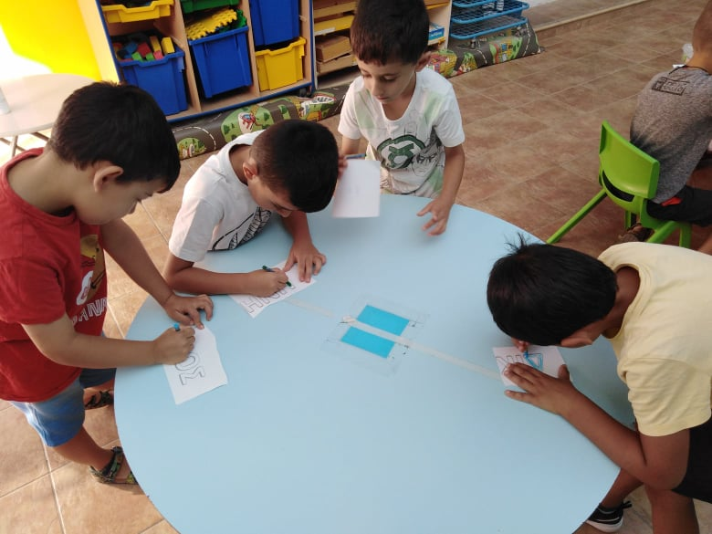
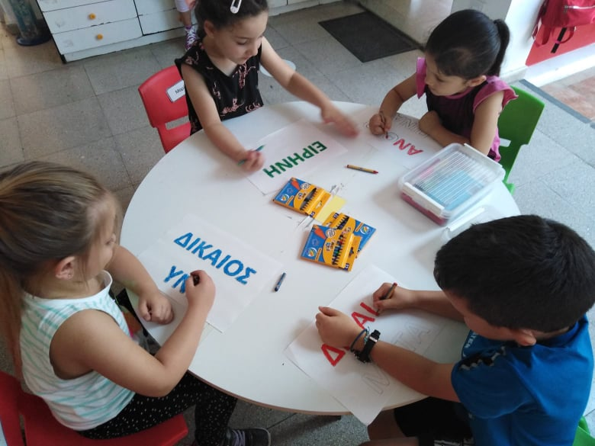
Children fill in the letters for Peace, Justice and Human rights

Slide 8
Our Poster was ready, and we send it!!! We are very happy that we will spread these messages that we are working also in our Erasmus project through our poster!!!

Slide 9
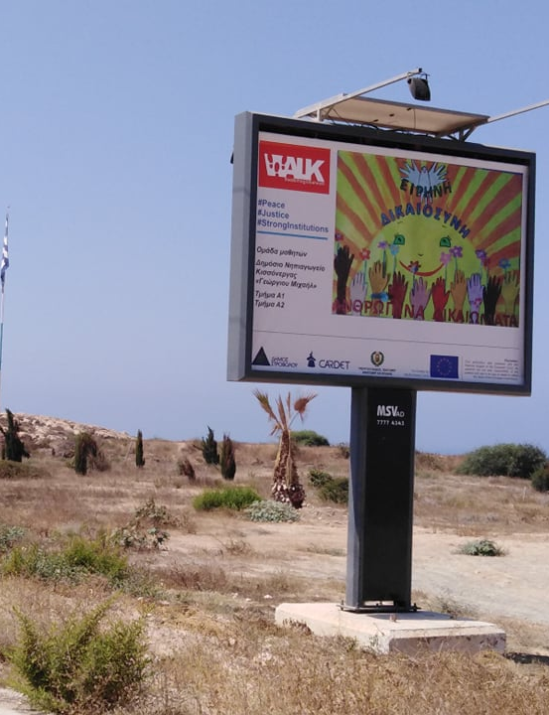
Happy and very proud to see our children’s poster in the roads spreading around great values!!!

