Slide 1
Kindergarten of Kissonerga
Erasmus+ Change your mind 4.0
2022-2023
Drama and other activities
By: Eleni Papakyriakou
Rodoula Ioannou
Andri Efstathiou

Slide 2
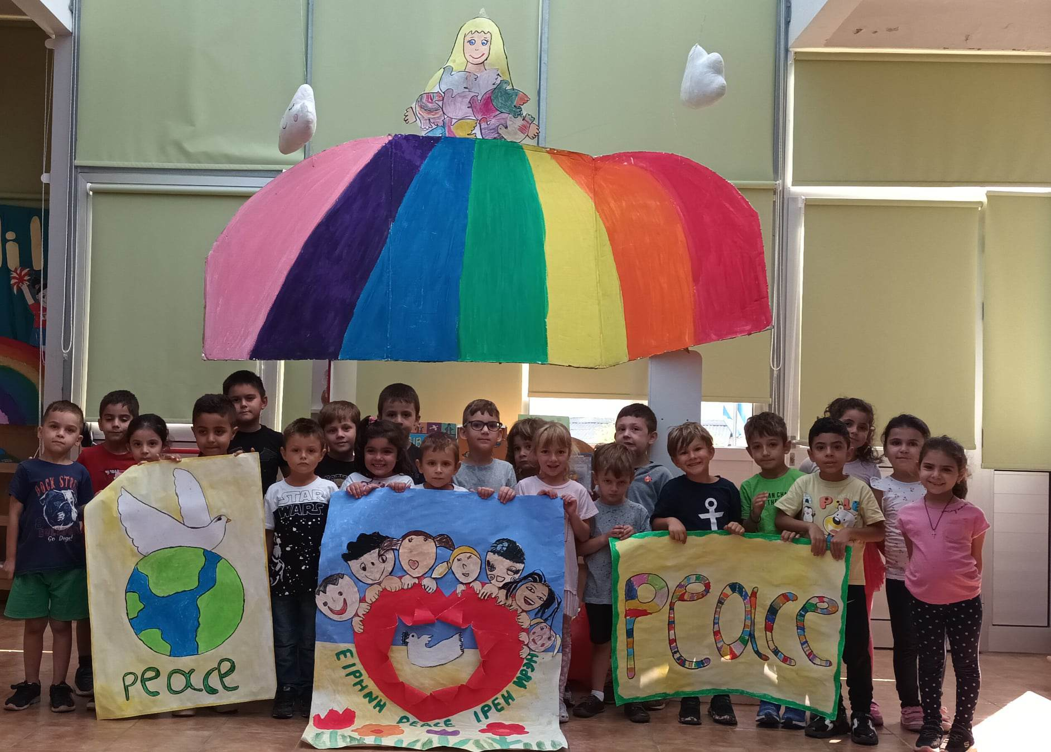
Learning about peace education A song for peace:
https://www.youtube.com/watch?v=OBlwFfrhYSc

Slide 3
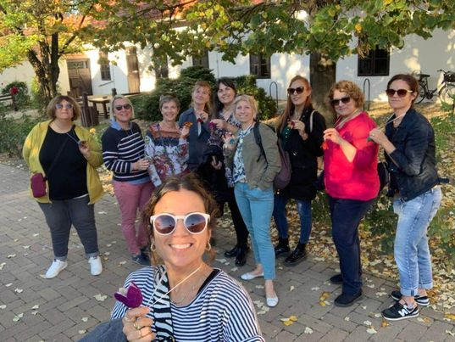
Drama activities began after the meeting in Hungary

Slide 4
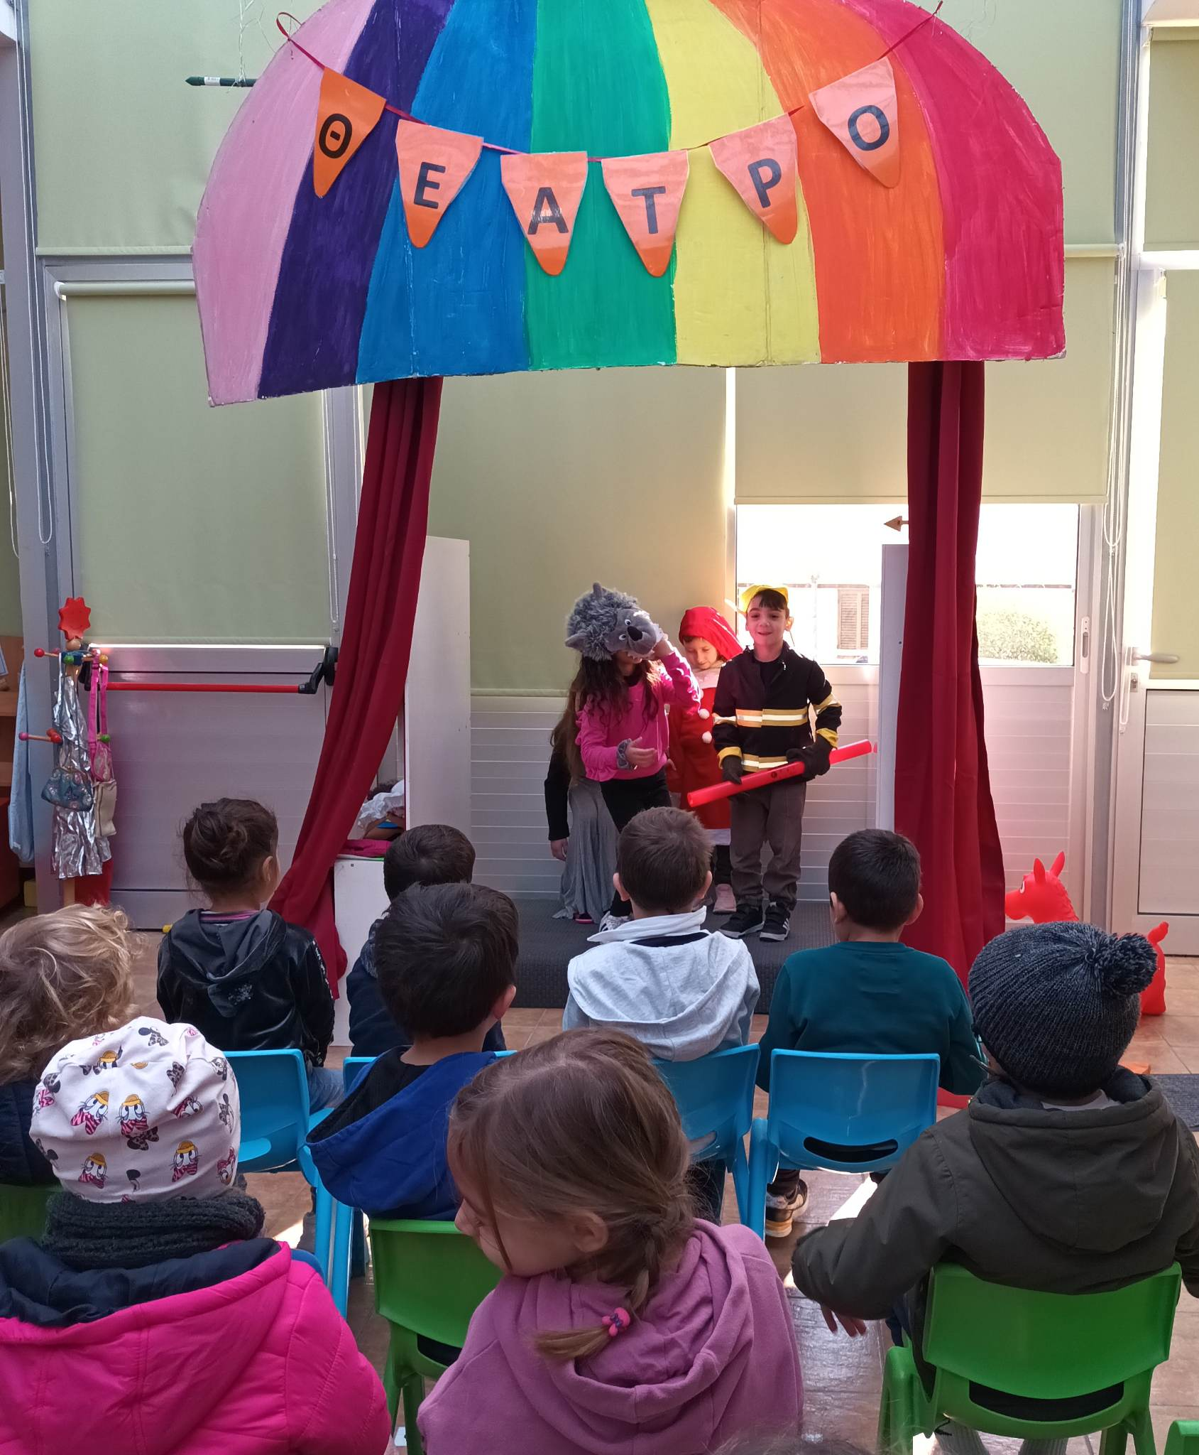
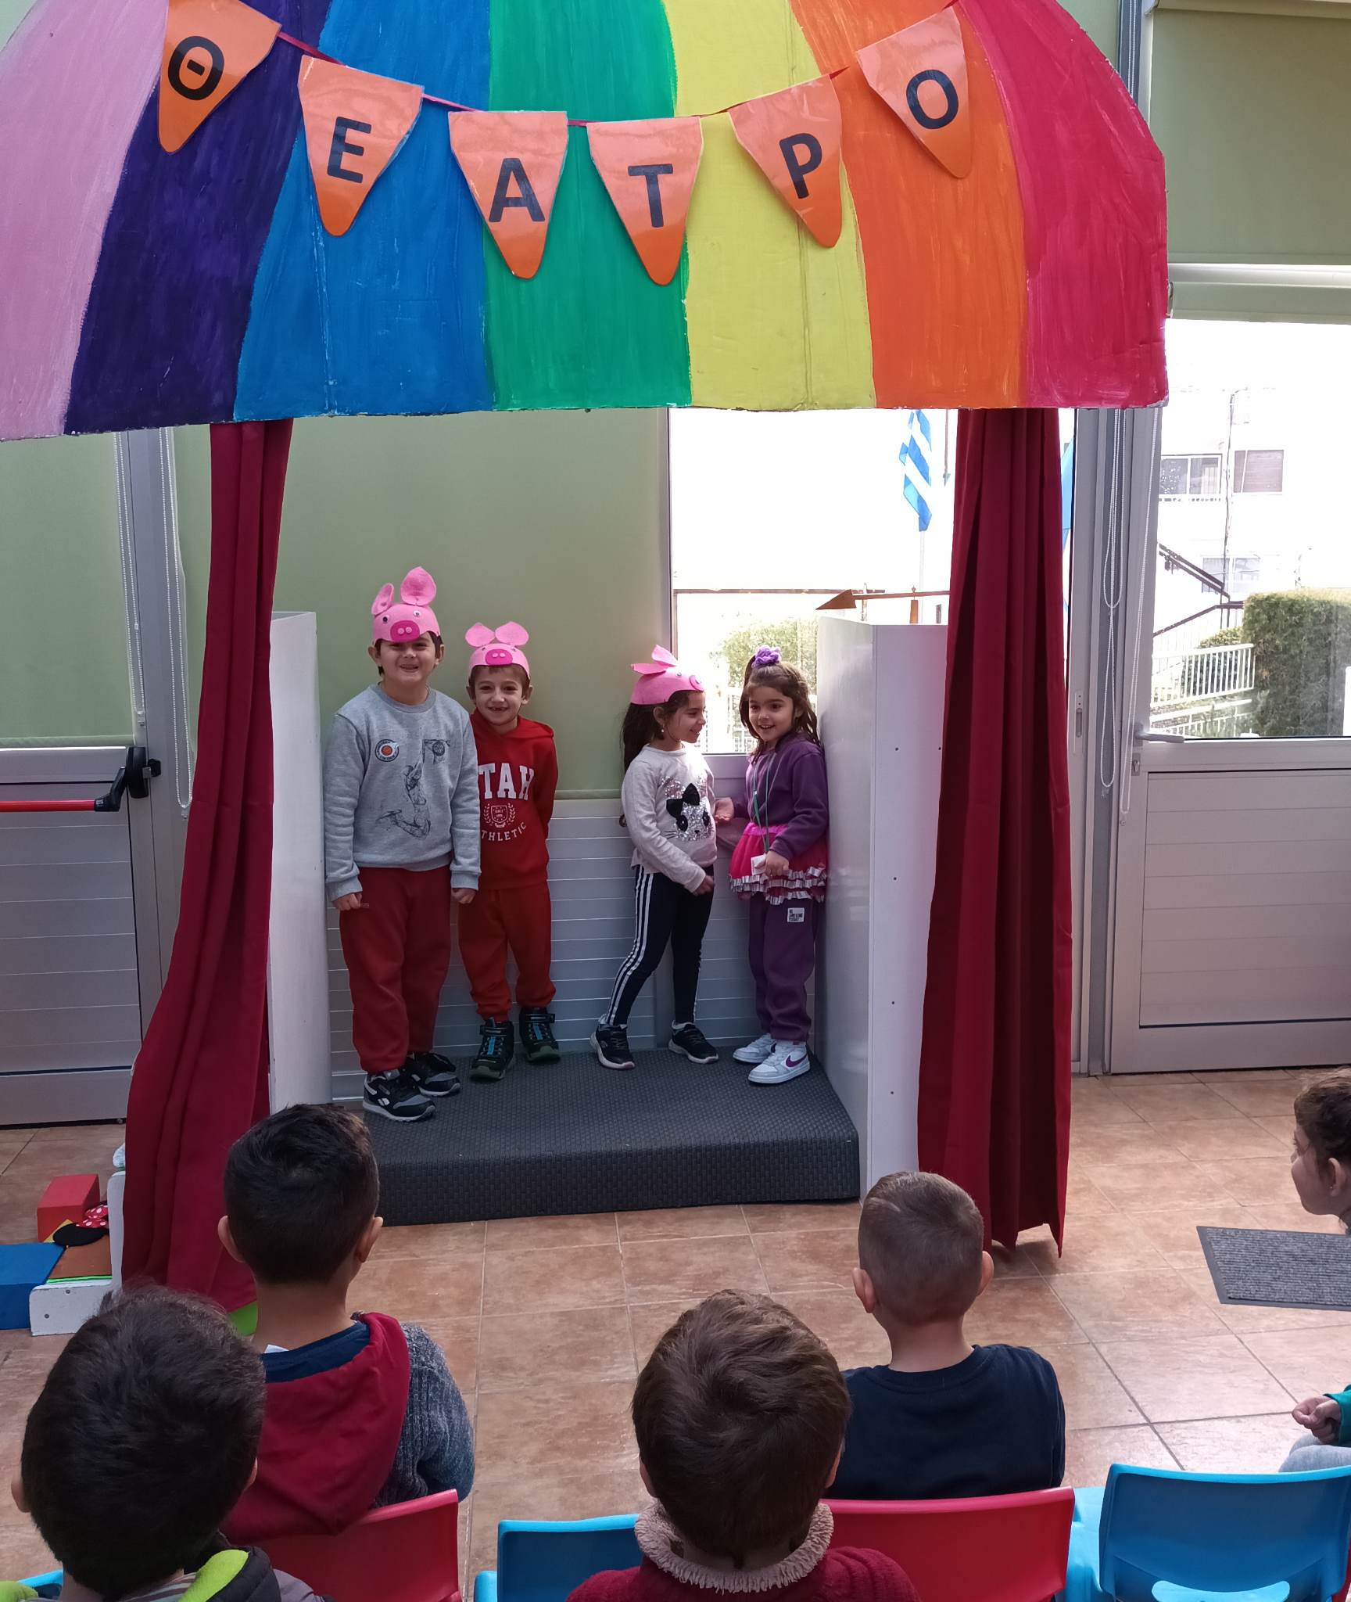
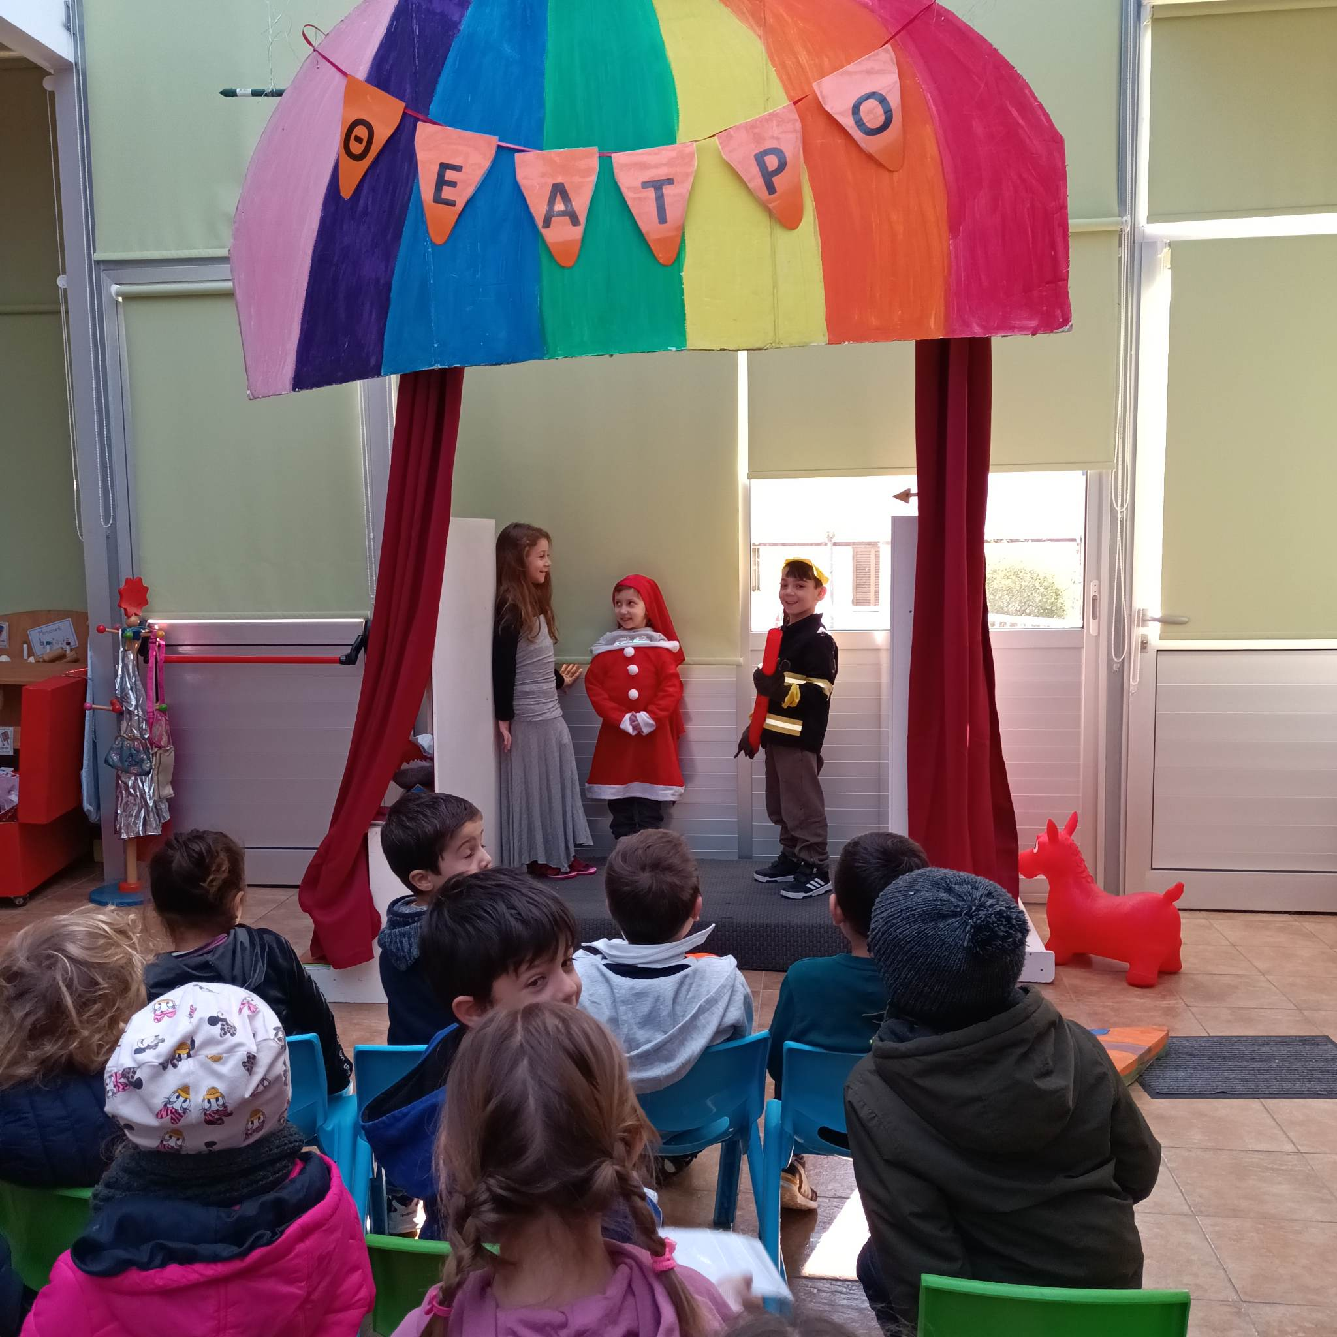
Playing theater for our classmates

Slide 5
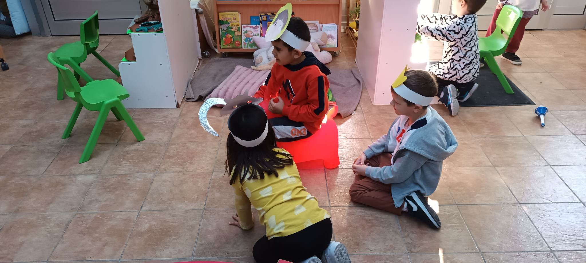
Making drama in the free activities

Slide 6
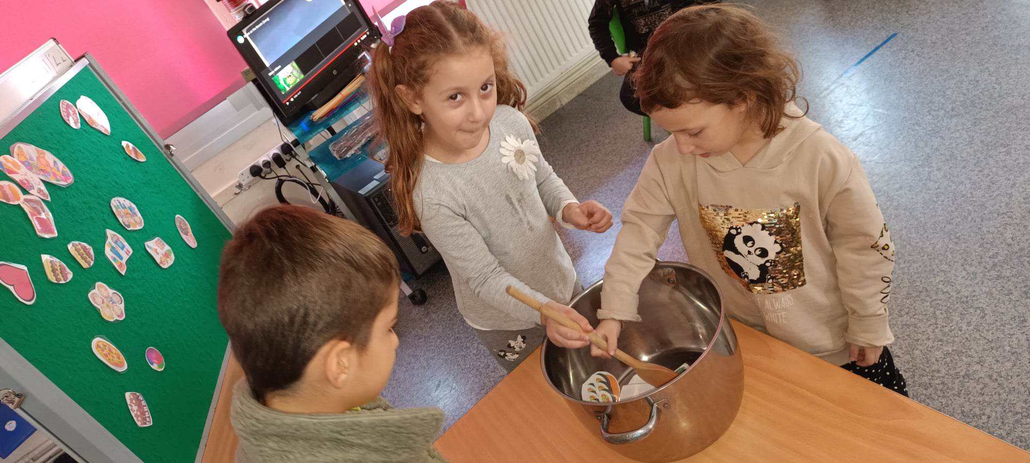
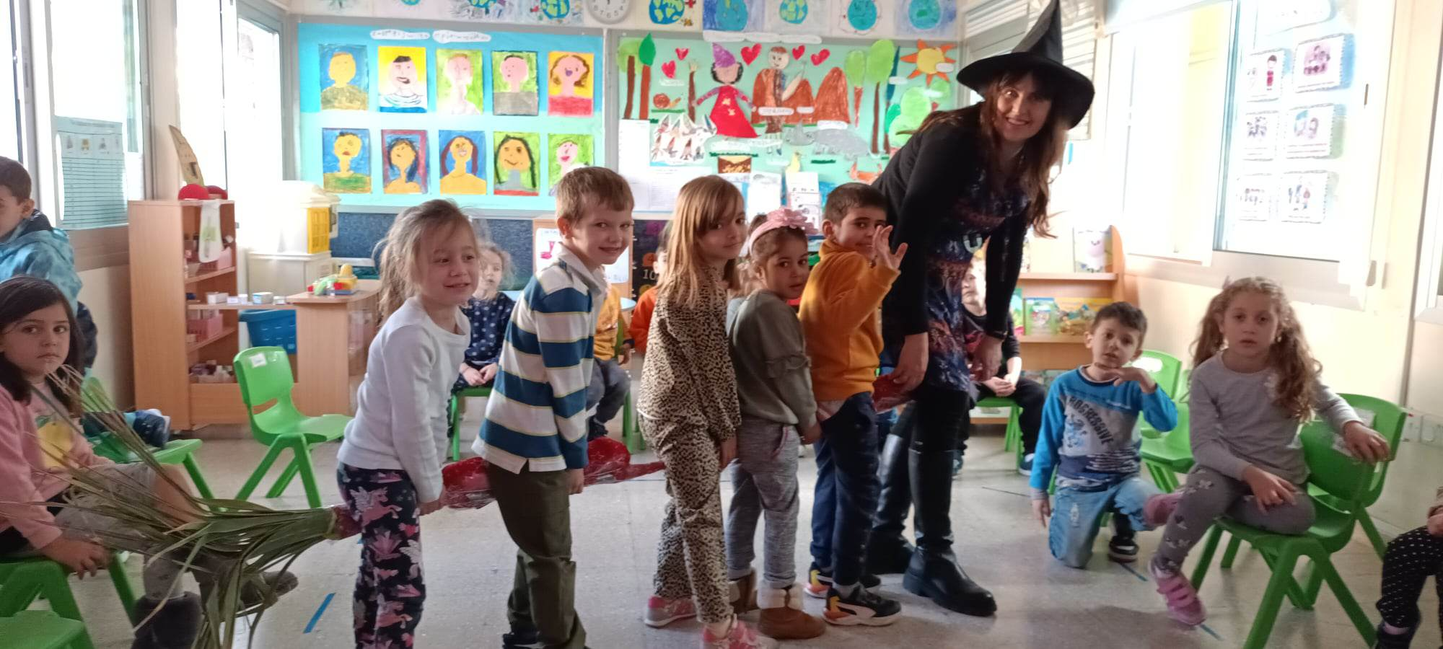
Drama in the classroom

Slide 7
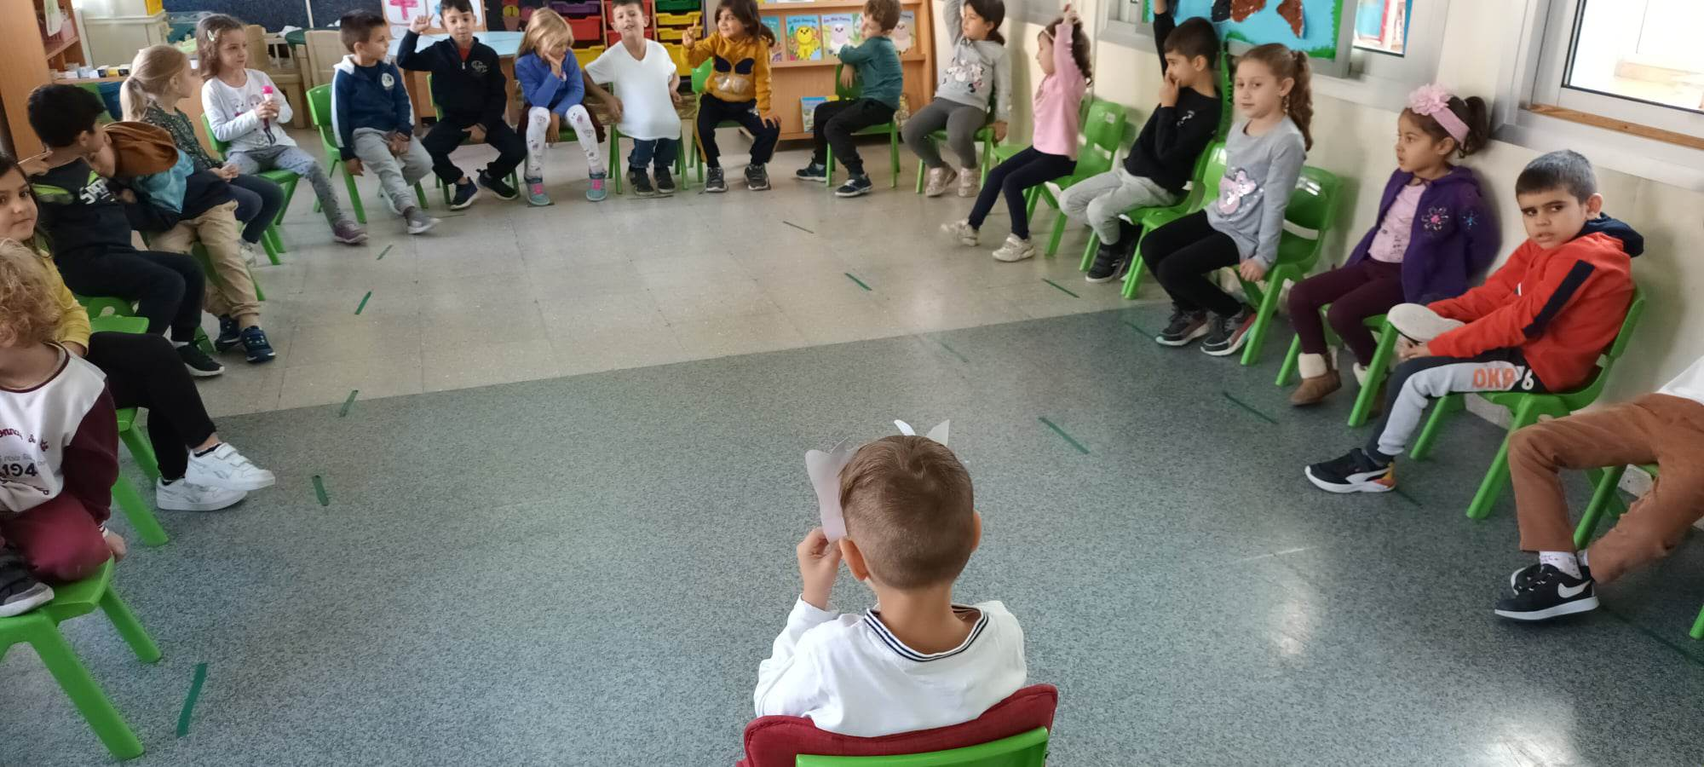
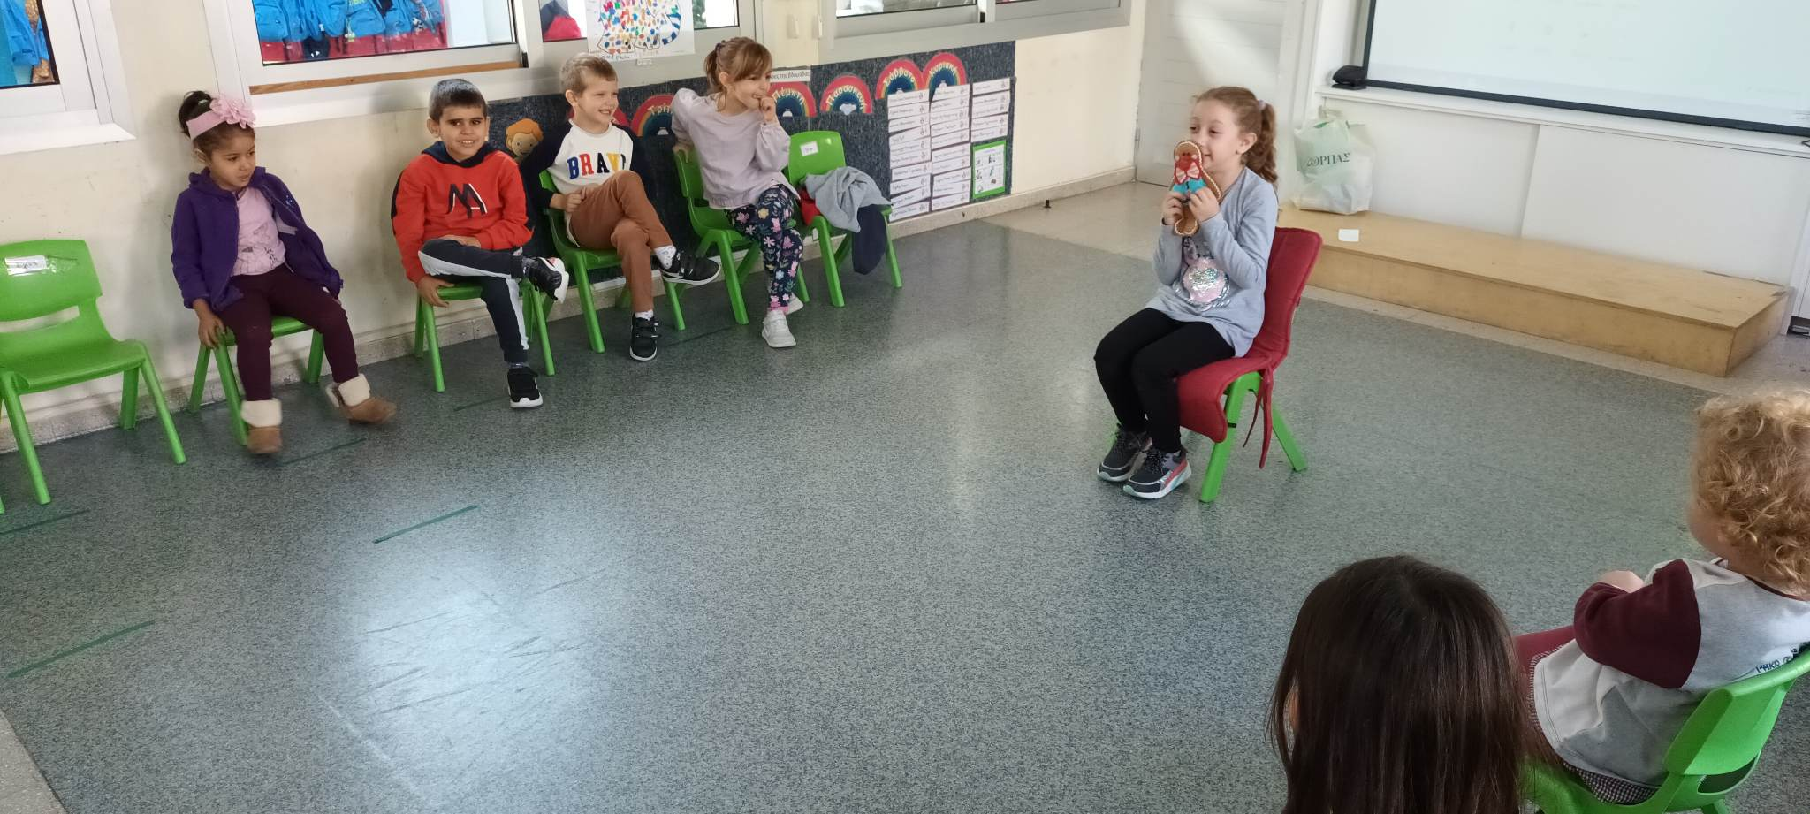
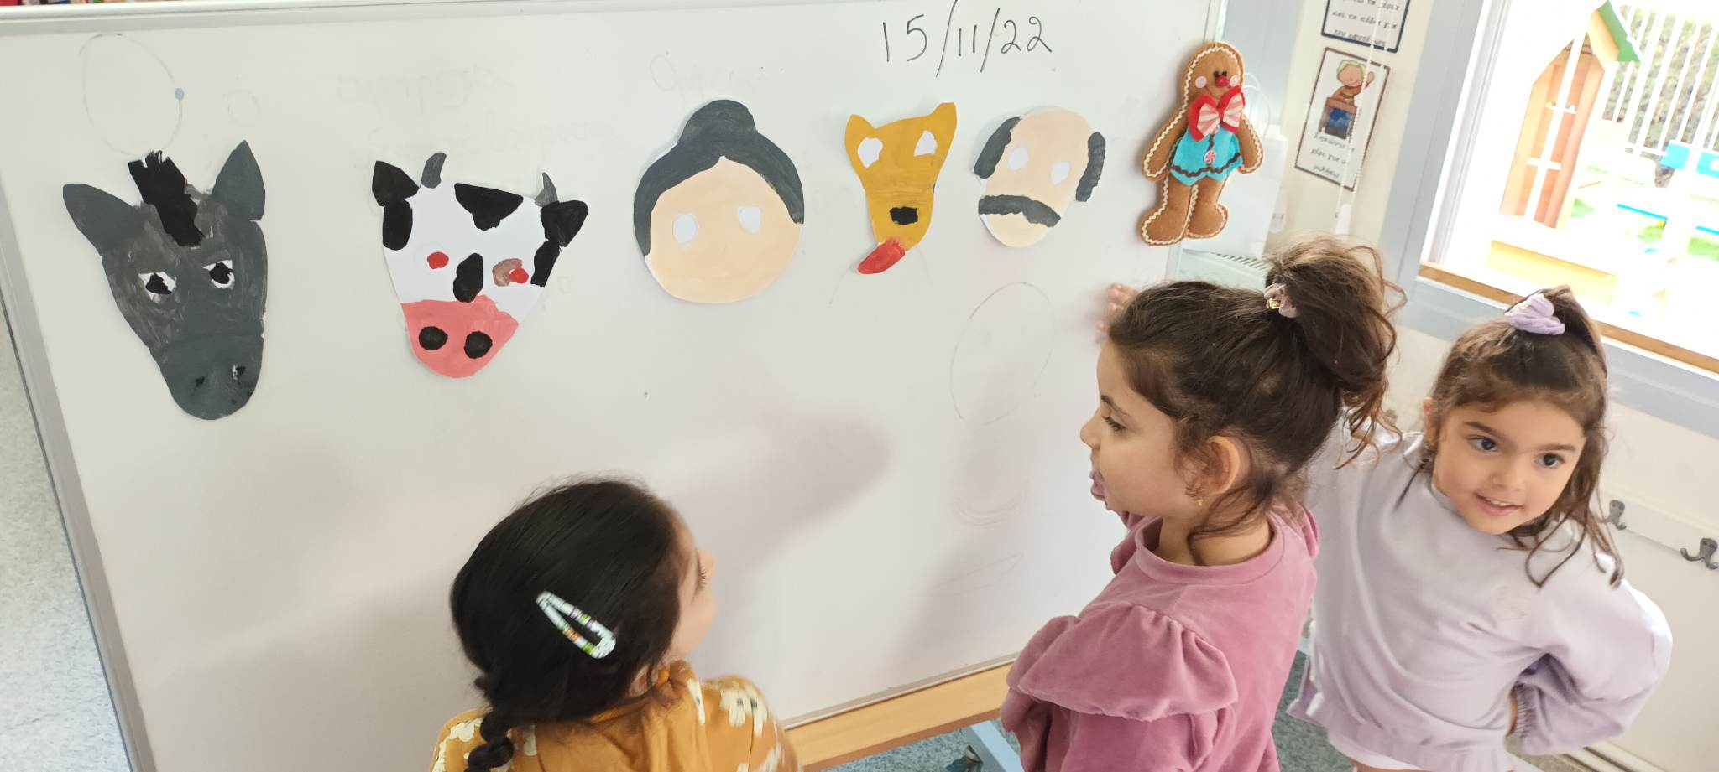
Making drama in the classroom , hot chair

Slide 8
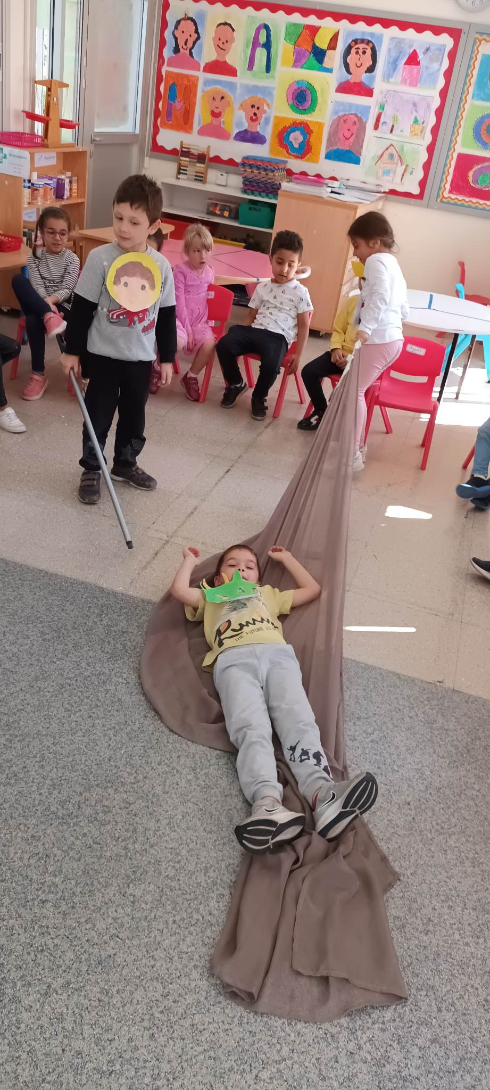
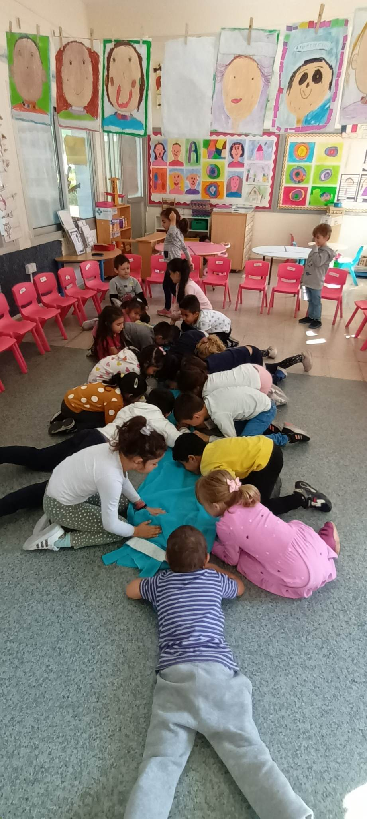
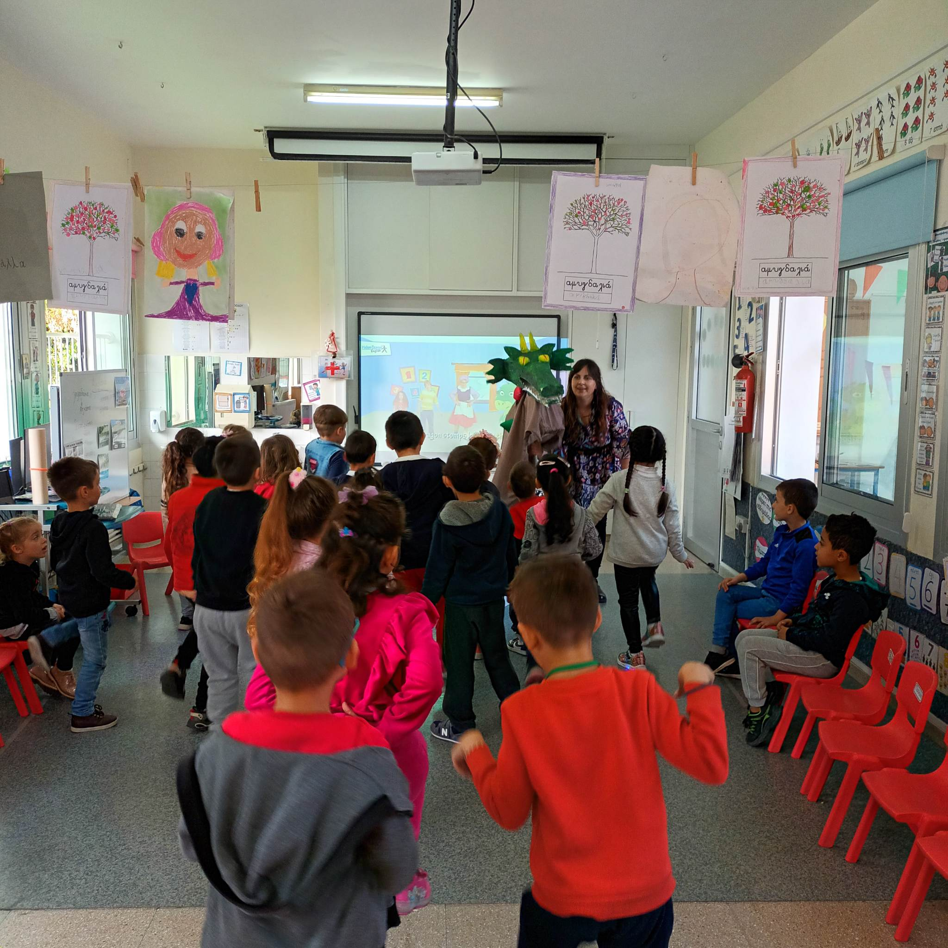
Making drama in the classroom

Slide 9
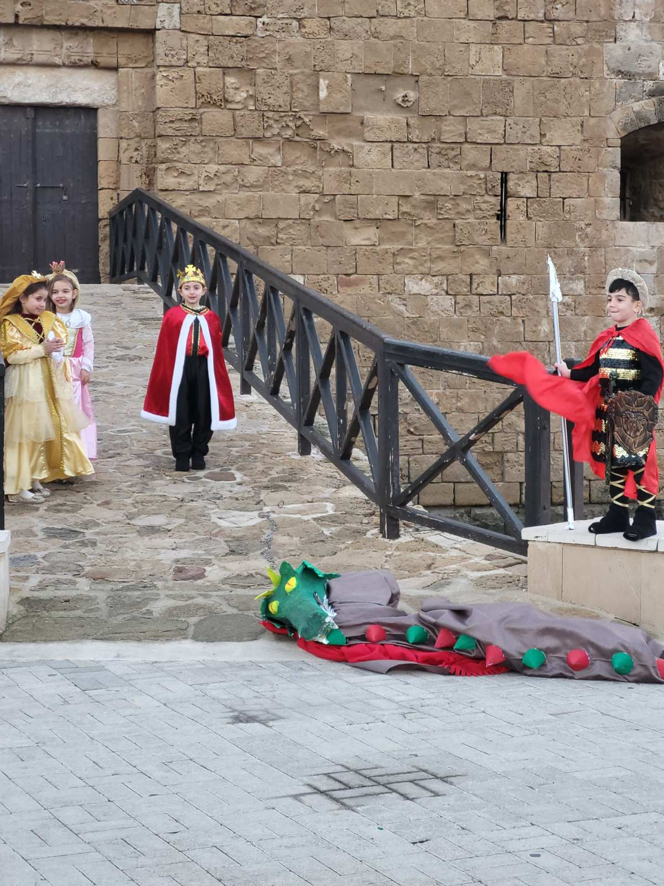
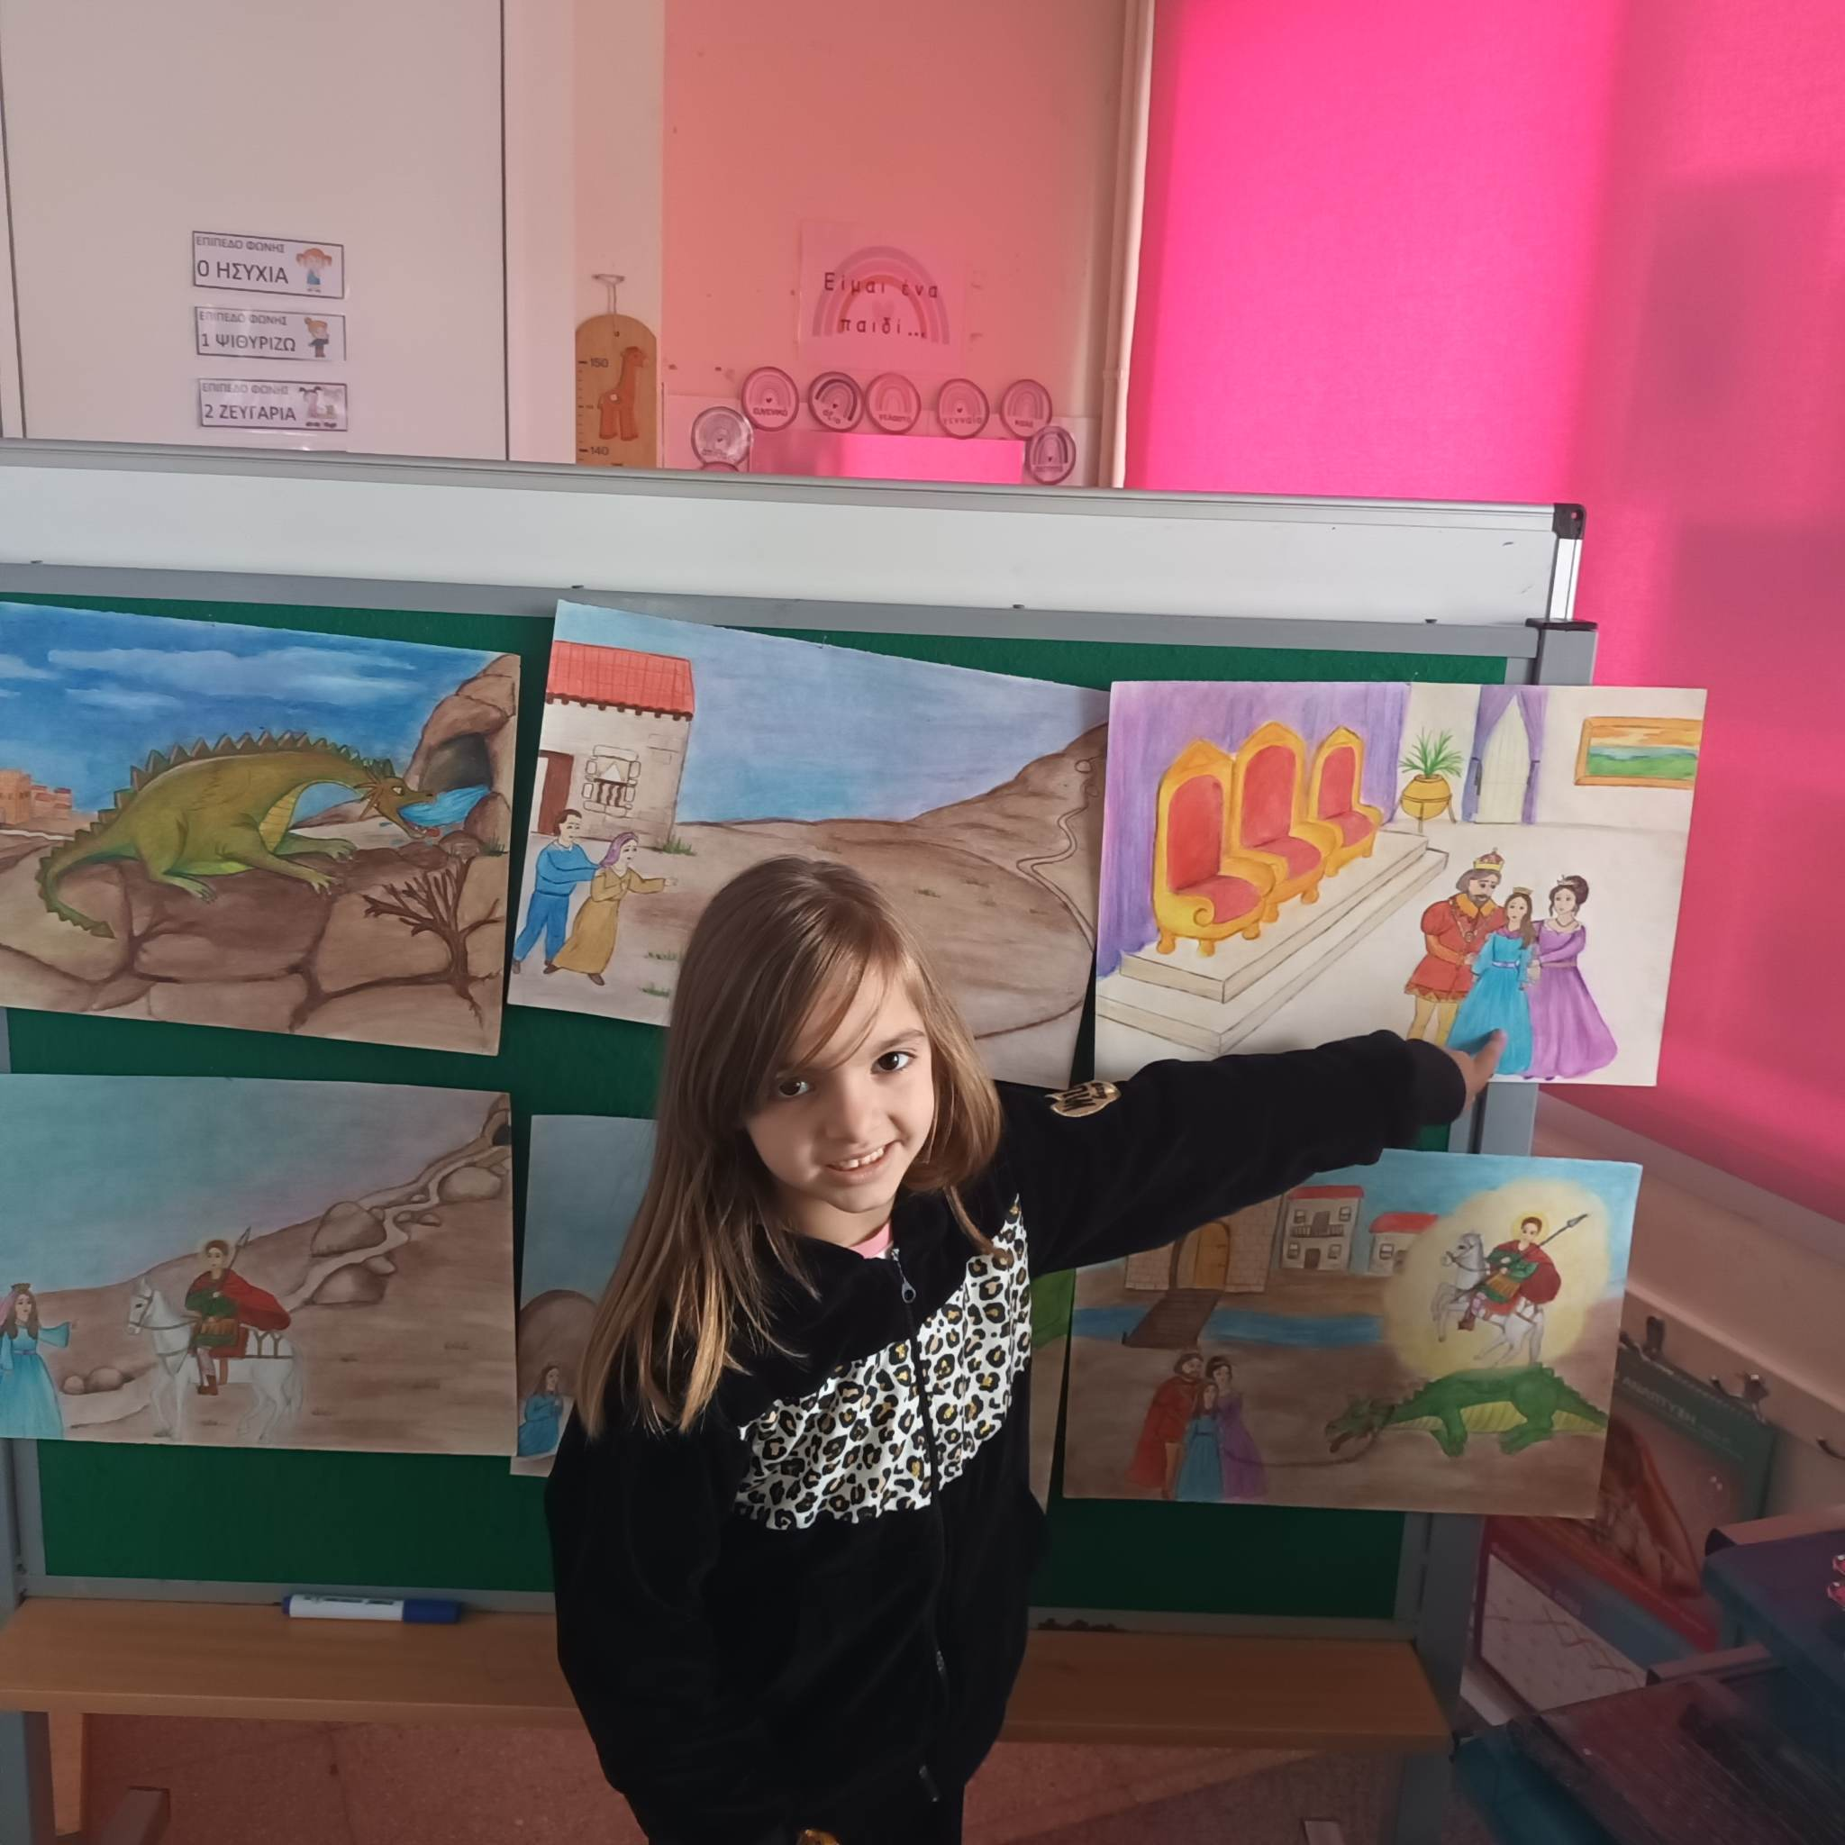
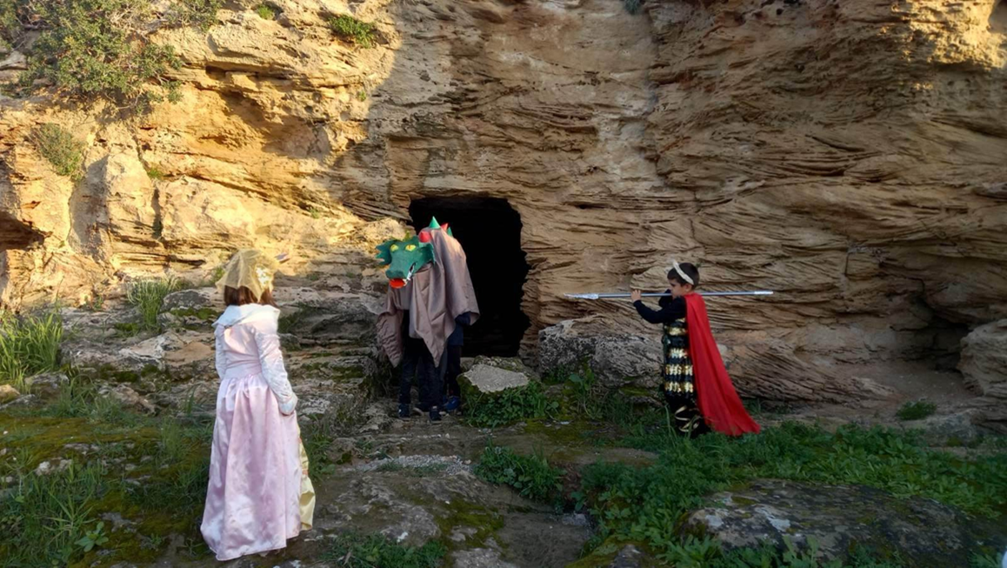
From the story to the movie

Slide 10
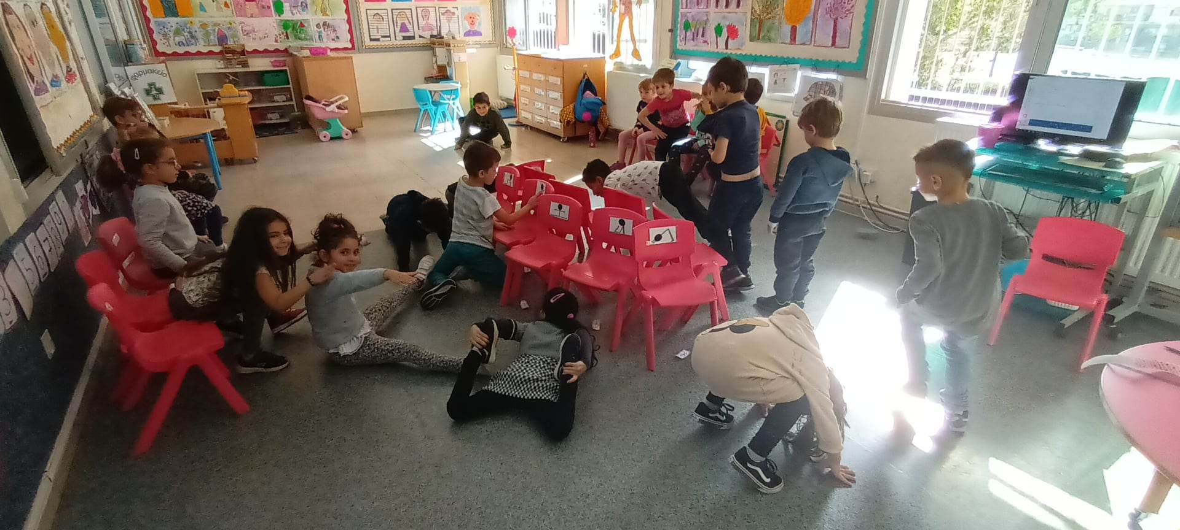
Dancing and moving games

Slide 11
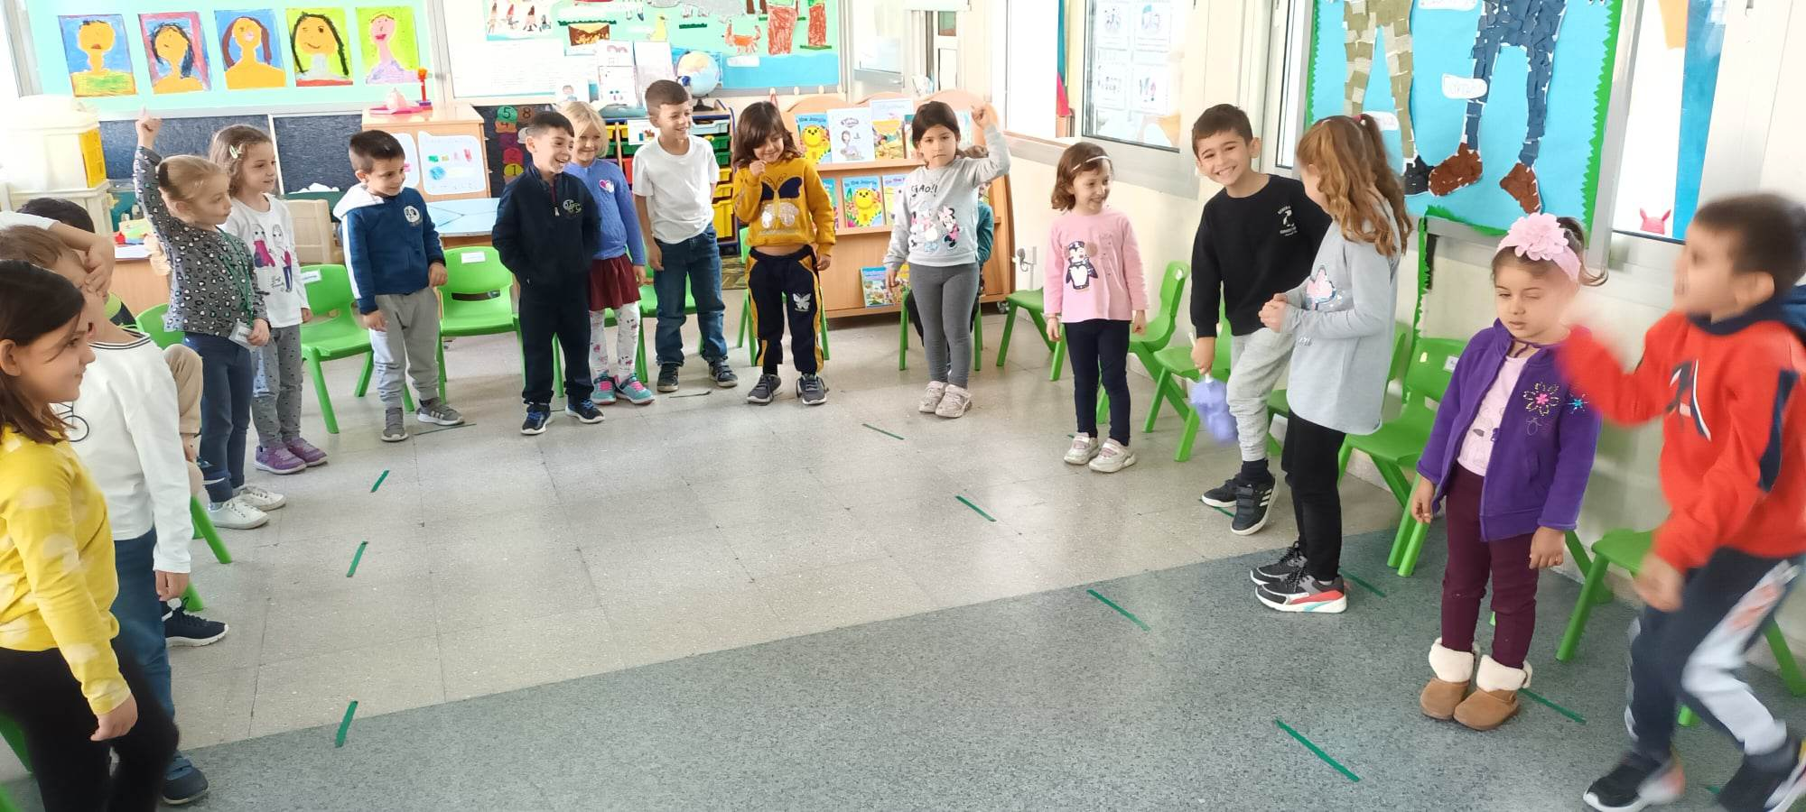
Dusting out the roles

Slide 12
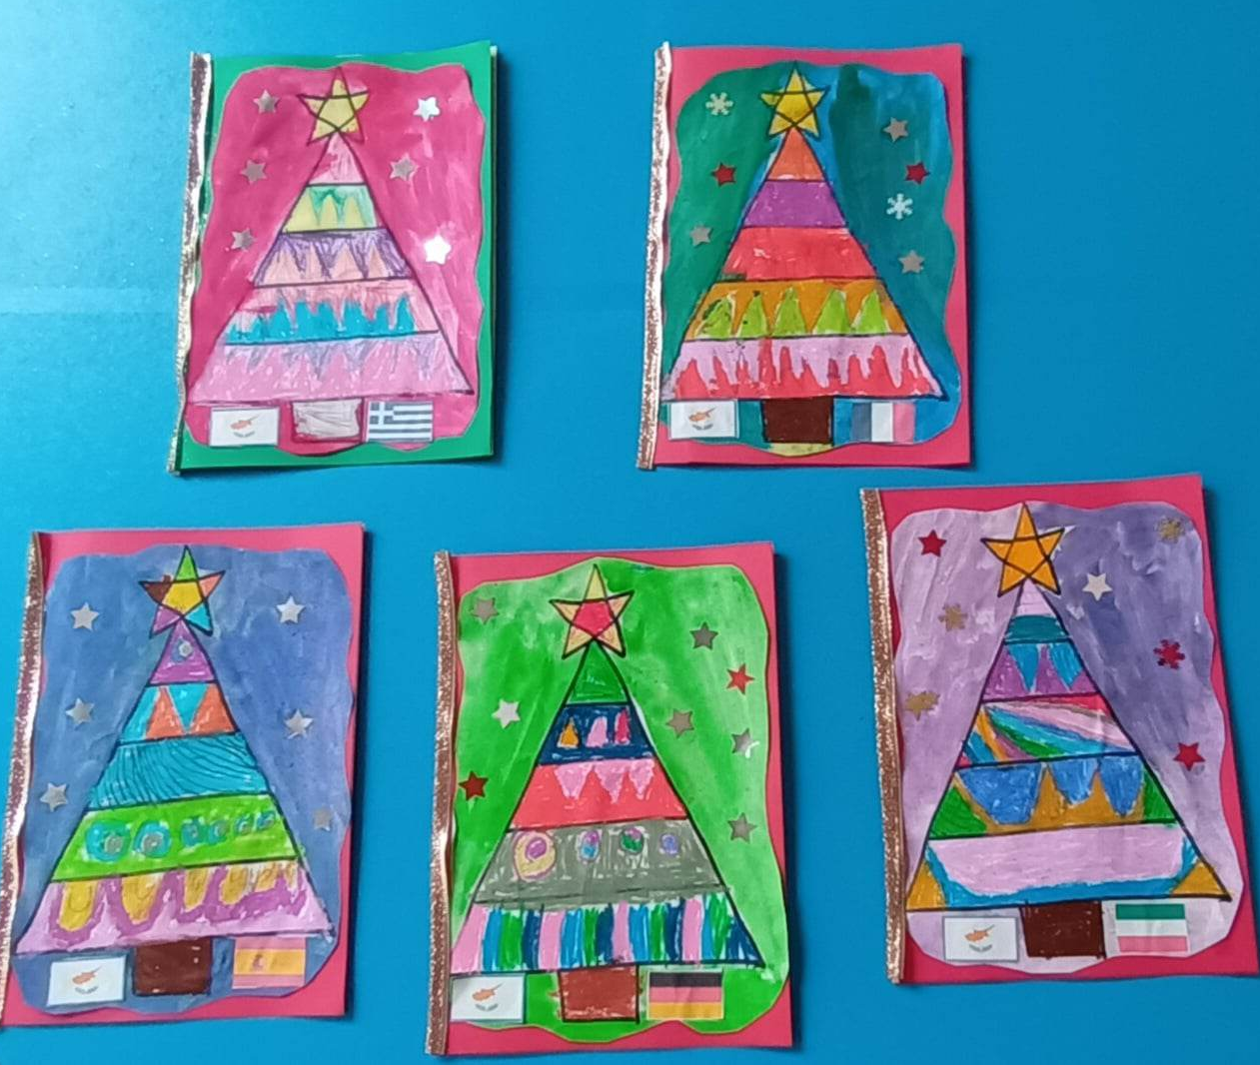
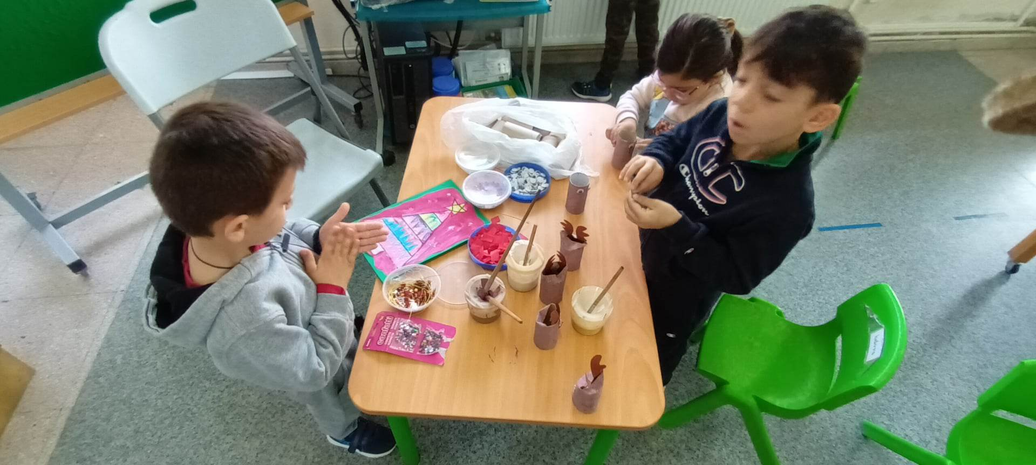
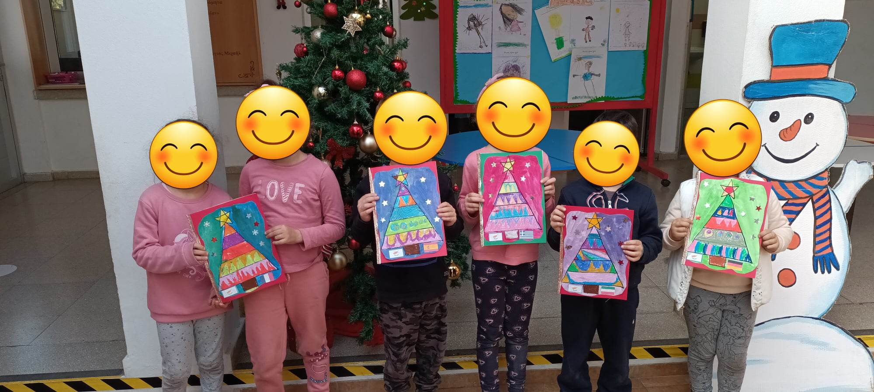
Making Christmas cards for our partners

Slide 13
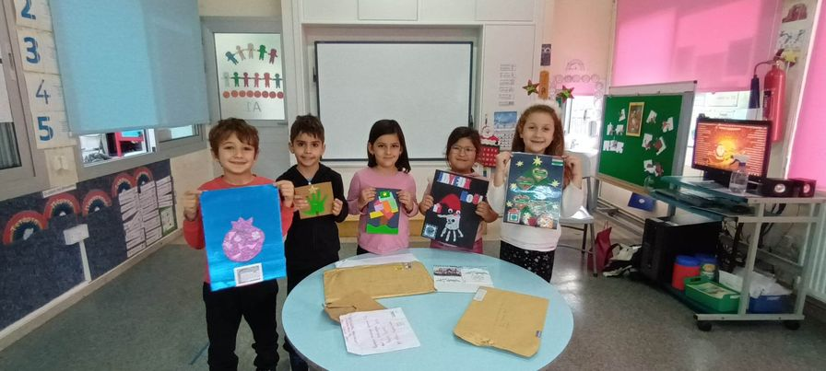
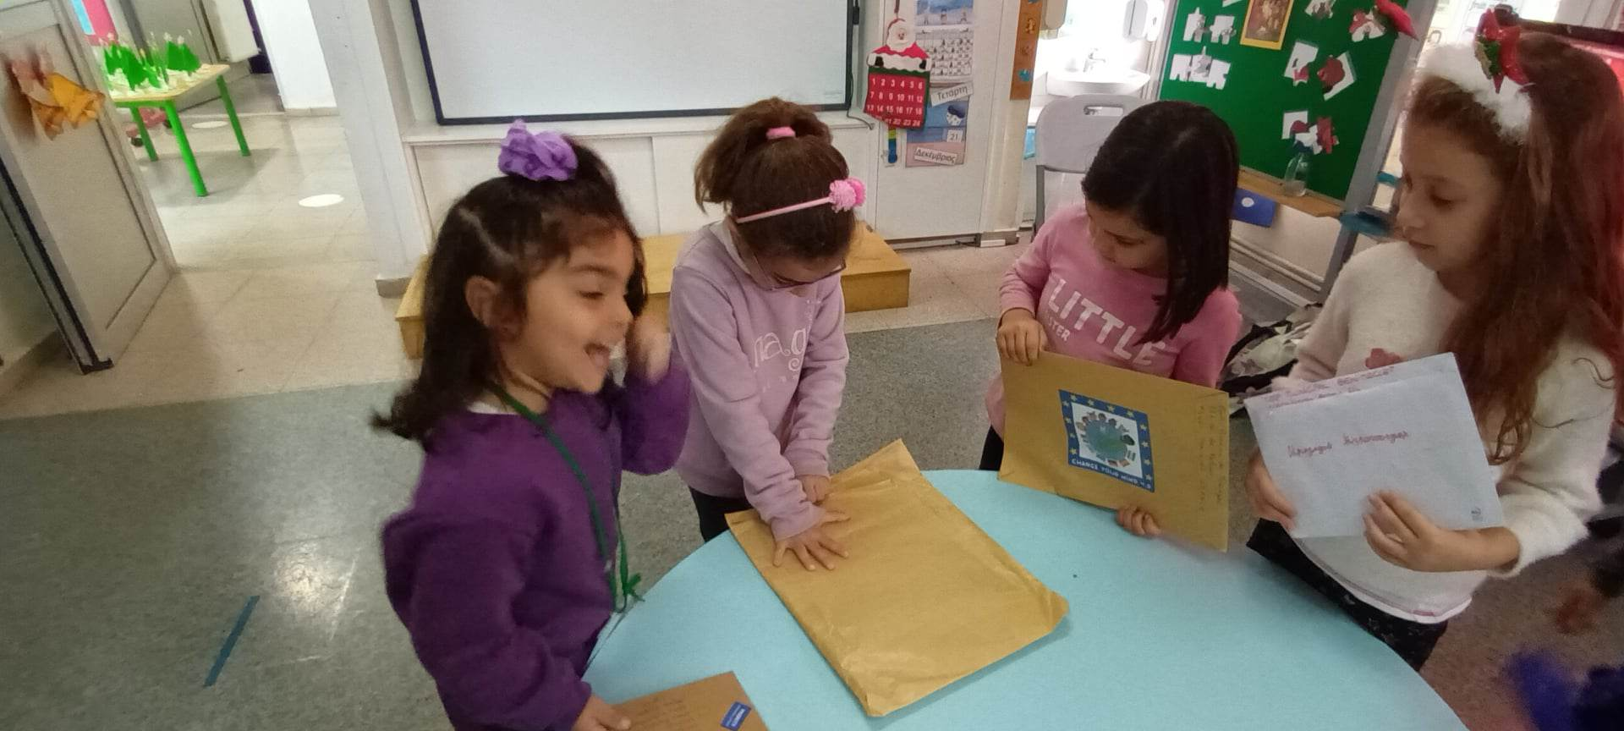
Receiving Christmas cards from our partners

Slide 14
Erasmus food days in our school
The children learn about this Greece and Chios island through the food the children brought and trough the teacher’s experience in Erasmus meeting
Link:
https://www.youtube.com/watch?v=ZPPHj_l3bFo

Slide 15
Erasmus food days in our school
The children learn about France and through the food the children brought and trough the teacher’s experience in Erasmus meeting
Link:
https://www.youtube.com/watch?v=eIxi1ogVQlY

Slide 16
Erasmus food days in our school
The children learn about our country Cyprus and through the food the children made with mothers and grandmothers and trough the teacher’s experience in Erasmus meeting
Link:
https://www.youtube.com/watch?v=cxmmyVxAVaQ

Slide 17
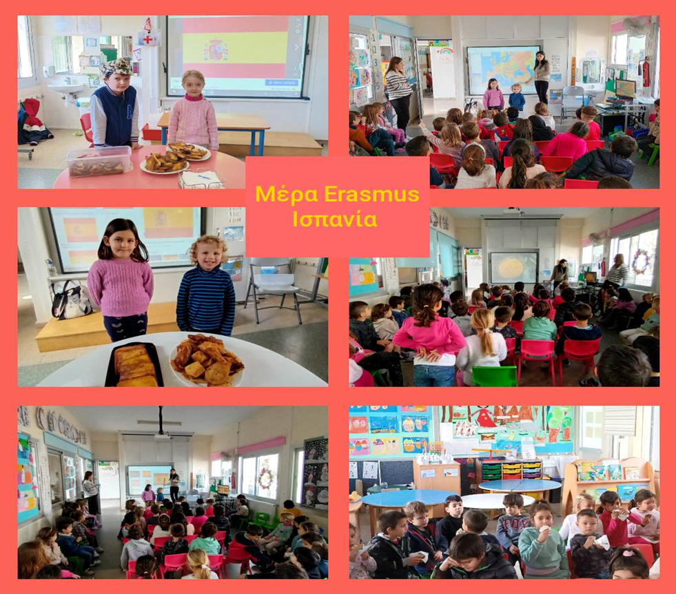
Erasmus food days in our school
The children learn about Spain and through the food the children brought and trough the teacher’s experience in Erasmus meeting
Link:
https://www.youtube.com/watch?v=bXD1-t1MV0g

Slide 18
Erasmus food days in our school
The children learn about Hungary and through the food the children brought and trough the teacher’s experience in Erasmus meeting
Link:
https://www.youtube.com/watch?v=slY255PYFi8

Slide 19
Erasmus food days in our school
The children learn about Germany and through the food the children brought waiting also the teacher’s experience in Erasmus meeting
Link:
https://youtu.be/2pxnQchnFHg

Slide 20
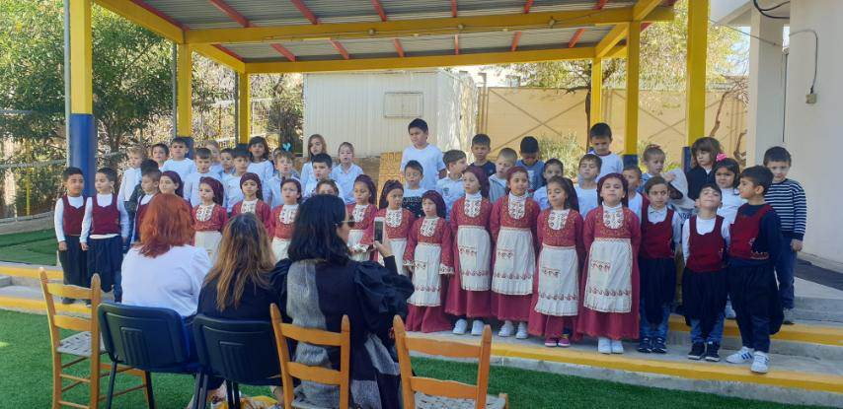
Erasmus meeting seminar for peace education in our school 7-9 of March
3rd year we participate in our Erasmus program with 5
other countries.New experiences and activities!
The stonesoup story book was the beginning of a new
journey when our partners from Germany came in Cyprus.
“Happiness is hidden in little things”
https://youtu.be/dMNNC8haN8o

Slide 21
Erasmus Change your mind more activities
A common Erasmus lip dub:
https://youtu.be/eUZrtsO1oOM
Creation of a new song and participation in the competition
Kanto na akoustei 2023
Τo synnefaki tis eirinis: https://youtu.be/OBlwFfrhYSc

Slide 22
Thank you for your attention!!!

